Slide 1
Rates backed vouchers
A solution to local bodies lack of finance

Slide 2
How councils can take back power
As you know, central governments accept national dollars for taxes. Their central bank can create new money.
A Reserve Bank economist has called this “our superpower”
Local governments should be able to do this too, with certain provisos.

Slide 3
It’s been done before in history
After they Napoleonic wars Guernsey’s infrastructure was falling apart. They had £19,000 public debt, on which they had to pay £2,300 interest a year. These were British pounds.
Their annual income was £3,000 a year.
A quirk in history was that Guernsey had been accorded the sovereign right to issue its own money in 1690. But they did not use this right till 1816.

Slide 4
Guernsey spent its own currency into existence
So, after a year’s deliberation they issued their own interest free currency, the Guernsey pound. They spent it into existence and accepted it for tax.
They also agreed to limit the issue to prevent inflation.
Four years later they built a public market with this money.
Subsequently schools and a sea wall were built with this money.

Slide 5
Part of the seawall built with Guernsey pounds in 1820
It has withstood two centuries of storms

Slide 6
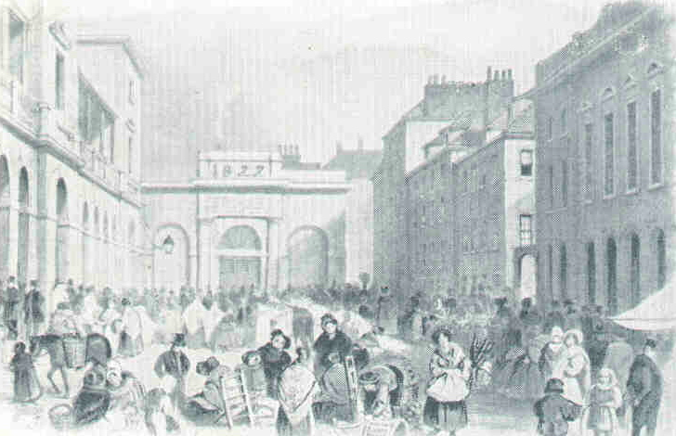
Guernsey Market Square 19th century

Slide 7
The miracle of worgl, Austria in the depression
In July 1932 in the depths of the Great Depression, the self educated Mayor of Wōrgl, Austria, had convinced his community advisory board that they needed a currency which circulated faster tham the national currency.
300 of its 4,300 inhabitants were out of work. There were another 1000 in the wider area.
He convinced the local businessmen and the newspaper they had nothing to lose by trying an emergency scrip.

Slide 8
The design of the currency made it circulate faster than national currency
They issued 20,000 local schillings worth of Work Certificates, also called local schillings in three different denominations.
They deposited the same amount of national schillings in the bank. This was so the local currency could be converted back with 2% fee.
The notes expired in a month. Then each note had to be validated with a stamp worth one tenth of the value of the note.
All town employees received half of their wages in local schillings.

Slide 9
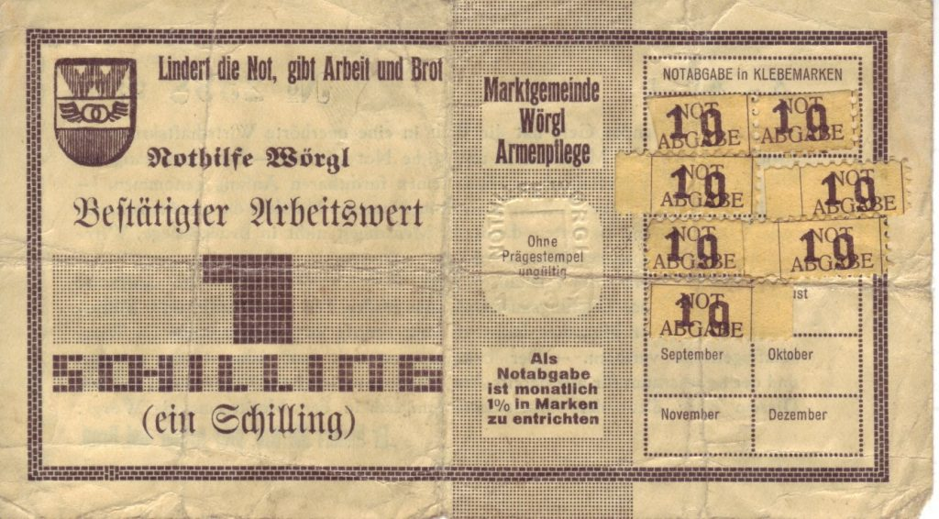

Slide 10
The dramatic result – “the miracle of worgl”
Within a year the 32,000 local schillings circulated 463 times.
Local taxes in arrears were paid back.
Seven streets were rebuilt, 12 roads were improved, the sewer system was extended, a ski jump and a bridge were built.
The number of unemployed fell by 16% in Wörgl, while in Austria it rose by 19%.

Slide 11
Worgl was the envy of many
Soon 200 other towns wanted to copy it.
But the commercial banks persuaded the State Bank to stop it.
Wōrgl went to the Supreme Court, but it lost.
The currency lasted just under 14 months.

Slide 12
For more information
https://unterguggenberger.org/the-free-economy-experiment-of-woergl-1932-1933/
https://www.transitionculture.org/2009/11/22/a-local-currency-pilgrimage-to-worgl/
https://observablehq.com/@martien/miracle-of-worgl
https://tontinecoffeehouse.com/2020/06/15/silvio-gesell-and-the-worgl-experiment/

Slide 13
in 1976 the Mayor of Hamilton New zealand tries to introduce a similar currency
Hamilton was paying 9.5% interest on its loans.
Mayor Bruce Beetham convinced 36% of the town that rates vouchers would help their economy and of these 56% were in favour.
He suggested paying employees and contractors partly in rates vouchers –up to one third of the total rates collected.

Slide 14
And Beetham’s Proposed solution could improve
The Wōrgl currency had a circulation incentive which made it even more effective. Results come much quicker.
Wōrgl council officers had to ensure there was no inflation. So when inflation did arrive, they withdrew a lot of the local currency until inflation had disappeared.

Slide 15
He was thwarted by local officials
Beetham sent his proposal to the head of the Audit Department, the Minister of Local Government, the City Solicitor, the Secretary of the Treasury and the Governor of the Reserve Bank.
The Reserve Bank was not encouraging.
The City Solicitor came up with three statutes that would have to be amended.

Slide 16
Further Reading New Zealand
https://deirdrekent.com/councils-rates-vouchers/ Blogpost written in May 2020 on a response to council’s lack of funding for infrastructure.
Read the description of the proposed Hamilton Rates Voucher here:
https://library.uniteddiversity.coop/Money_and_Economics/Healthy_Money_Healthy_Planet_Draft.pdf Go to page 294

Slide 17
Living Economies Educational Trust
Established in 2002, the Living Economies Educational Trust whose purpose is to promote learning about currencies and systems of exchange that foster community well-being and strength regional currencies. See http://livingeconomies.nz.
Deirdre Kent deirdre.kent@gmail.com and Phil Stevens phil@livingeconomies.nz of Living Economies have created this powerpoint for your consideration.
https://livingeconomies.nz/

